Slide 1

SCS1301 - OPERATING SYSTEM
UNIT – 3
SYNCHRONIZATION & DEADLOCK
(FROM DEADLOCKS TOPIC)
Ms. B KEERTHI SAMHITHA
ASSISTANT PROFESSOR
DEPARTMENT OF CSE
SCHOOL OF COMPUTING

Slide 2
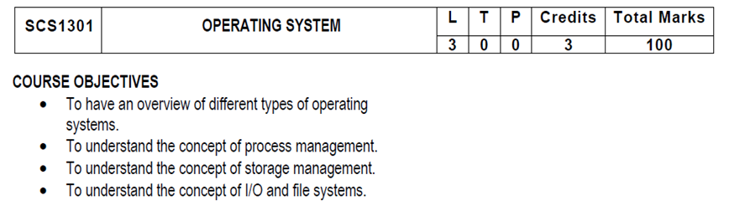
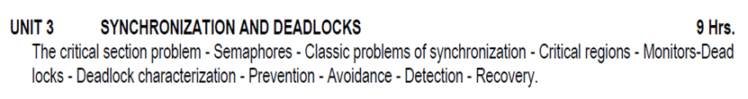
SYLLUBUS

Slide 3
COURSE OUTCOMES
SCS1301.1 | Comprehend knowledge about Operating system components and services.
SCS1301.2 | Apply knowledge of process scheduling algorithms for a given context.
SCS1301.3 | Analyze process synchronization and deadlock conditions.
SCS1301.4 | Construct the process of Mapping logical address to physical address.
SCS1301.5 | Design appropriate strategies for Paging, Segmentation.
SCS1301.6 | Develop real time applications Based on Linux shell programming.

Slide 4
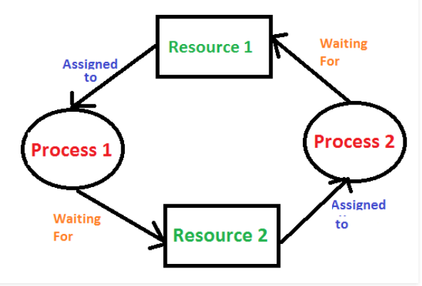
DEADLOCKS
Deadlocks are a set of blocked processes each holding a resource and waiting to acquire a resource held by another process.

Slide 5
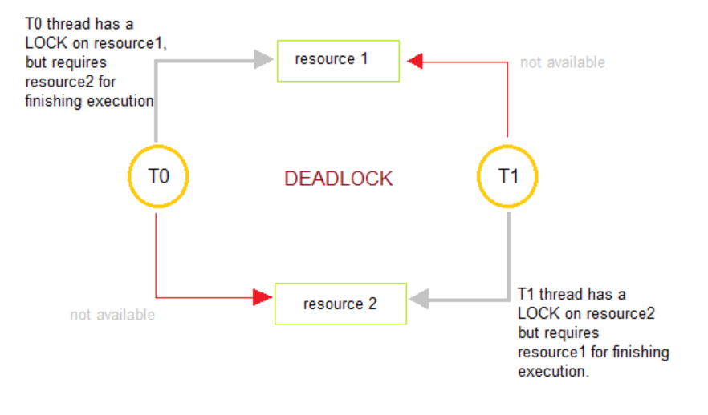
A deadlock happens in operating system when two or more processes need some resource to complete their execution that is held by the other process.

Slide 6
STARVATION
Starvation, process with high priorities continuously uses the resources preventing low priority process to acquire the resources.
Starvation can be defined as when a process request for a resource and that resource has been continuously used by the other processes then the requesting process faces starvation.
In starvation, a process ready to execute waits for CPU to allocate the resource. But the process has to wait indefinitely as the other processes continuously block the requested resources.

Slide 7
AGING
Aging can resolve the problem of starvation.
Aging gradually increases the priority of the process that has been waiting long for the resources.
Aging prevents a process with low priority to wait indefinitely for a resource.

Slide 8
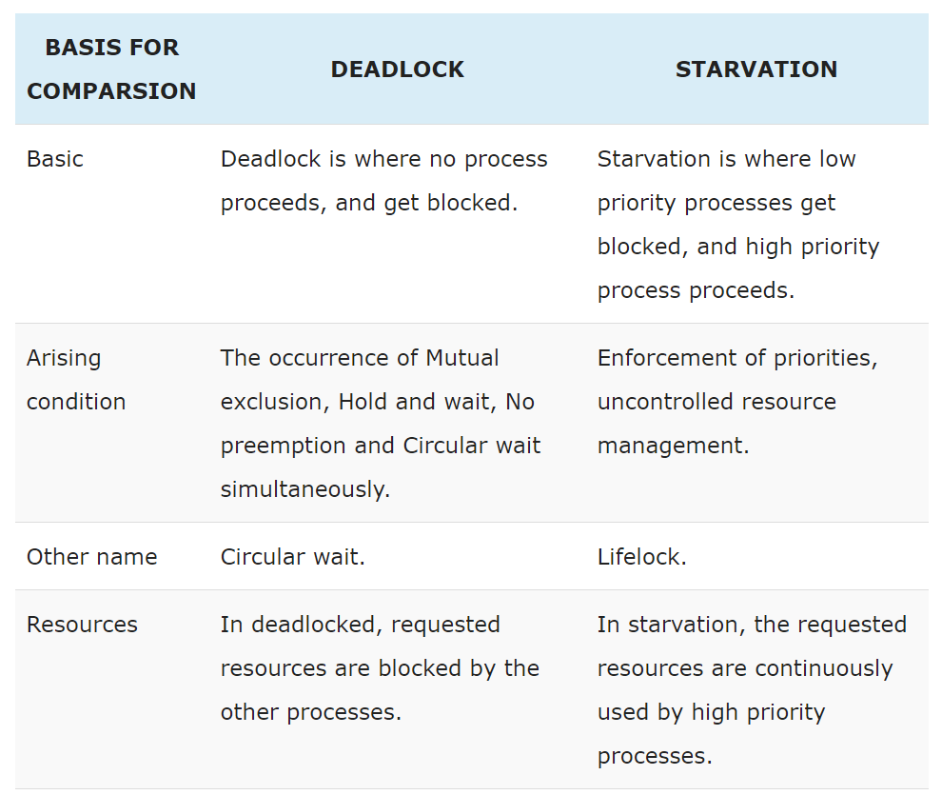

Slide 9
Sr. | Deadlock | Starvation
1 | Deadlock is a situation where no process got blocked and no process proceeds | Starvation is a situation where the low priority process got blocked and the high priority processes proceed.
2 | Deadlock is an infinite waiting. | Starvation is a long waiting but not infinite.
3 | Every Deadlock is always a starvation. | Every starvation need not be deadlock.
4 | The requested resource is blocked by the other process. | The requested resource is continuously be used by the higher priority processes.
5 | Deadlock happens when Mutual exclusion, hold and wait, No preemption and circular wait occurs simultaneously. | It occurs due to the uncontrolled priority and resource management.

Slide 10
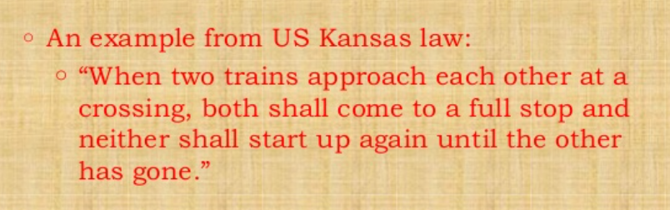
DEADLOCKS

Slide 11
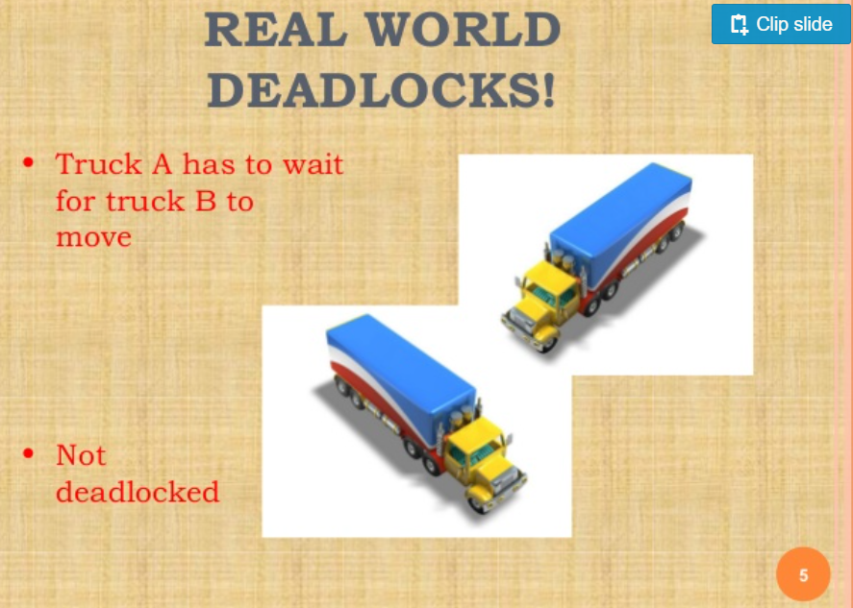
EXAMPLE

Slide 12
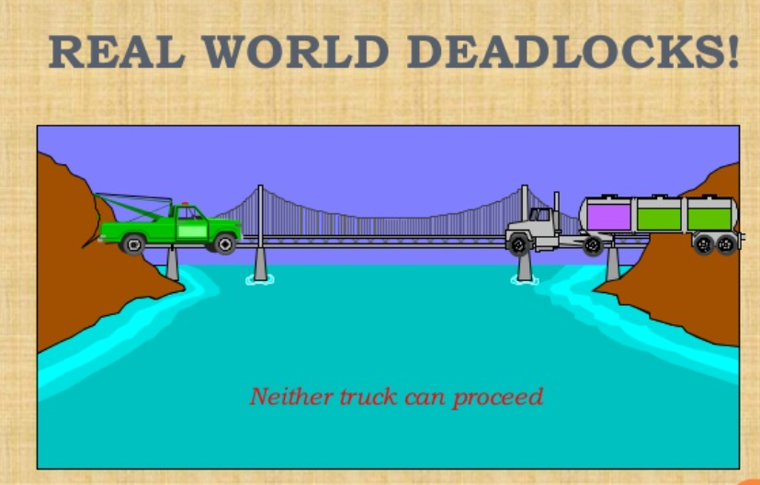
EXAMPLE

Slide 13
What is Deadlock?
Deadlock is a situation that occurs in OS when any process enters a waiting state because another waiting process is holding the demanded resource.
Deadlock is a common problem in multi-processing where several processes share a specific type of mutually exclusive resource known as a soft lock or software.

Slide 14
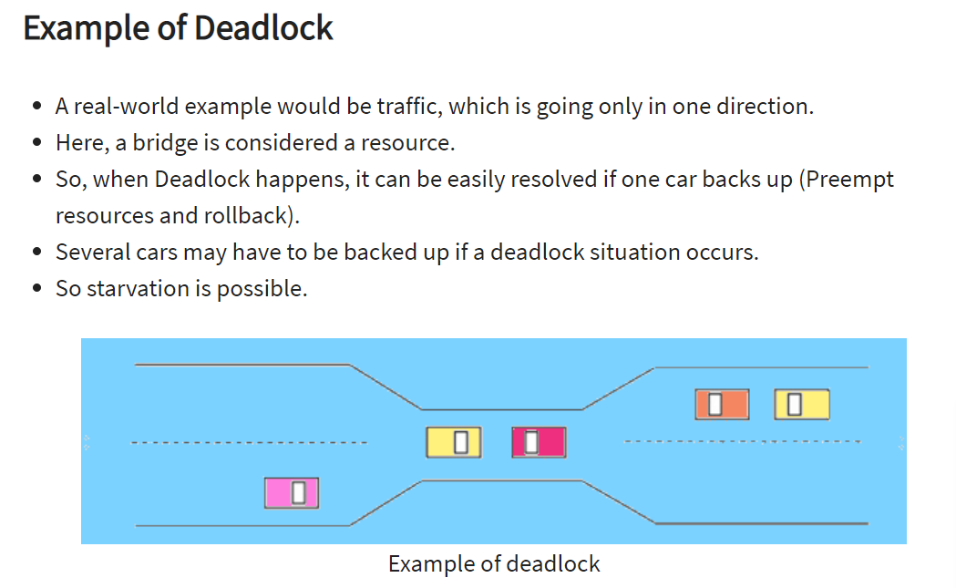

Slide 15
What is Circular wait?
One process is waiting for the resource, which is held by the second process, which is also waiting for the resource held by the third process etc.
This will continue until the last process is waiting for a resource held by the first process. This creates a circular chain.
For example, Process A is allocated Resource B as it is requesting Resource A. In the same way, Process B is allocated Resource A, and it is requesting Resource B. This creates a circular wait loop.

Slide 16
Example of Circular wait
For example, a computer has three USB drives and three processes. Each of the three processes able to holds one of the USB drives. So, when each process requests another drive, the three processes will have the deadlock situation as each process will be waiting for the USB drive to release, which is currently in use. This will result in a circular chain.

Slide 17
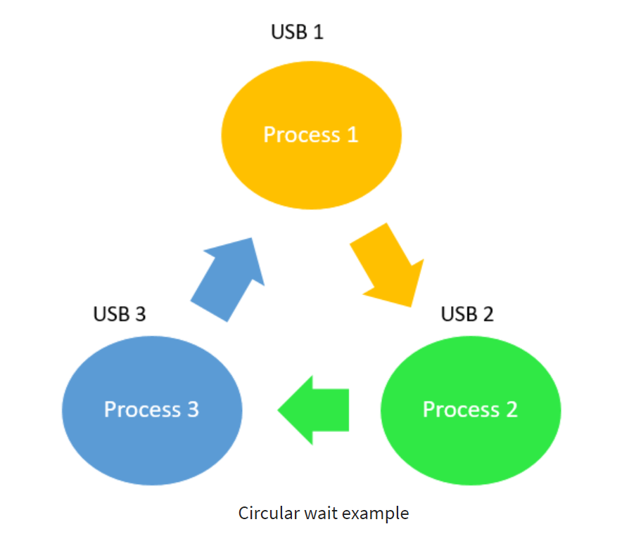

Slide 18
METHODS FOR HANDLING DEADLOCK
There are three ways to handle deadlock
Deadlock prevention or avoidance: The idea is to not let the system into deadlock state.
Deadlock detection and recovery: Let deadlock occur, then do preemption to handle it once occurred.
Ignore the problem all together: If deadlock is very rare, then let it happen and reboot the system. This is the approach that both Windows and UNIX take.

Slide 19
DEADLOCK METHODS or DEADLOCK STRATEGIES
The Deadlock Problem
System Model
Deadlock Characterization
Methods for Handling Deadlocks
Deadlock Prevention
Deadlock Avoidance
Deadlock Detection
Recovery from Deadlock

Slide 20
THE DEADLOCK PROBLEM
A set of blocked processes each holding a resource and waiting to acquire a resource held by another process in the set.
Example
System has 2 tape drives.
P0 and P1 each hold one tape drive and each needs another one.
Example
semaphores A and B, initialized to 1
P0 P1
wait (A); wait(B)
wait (B); wait(A)

Slide 21
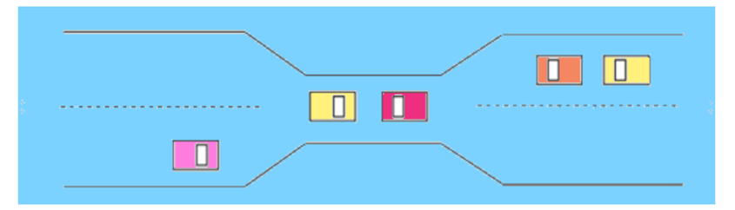
Example
Traffic only in one direction.
Each section of a bridge can be viewed as a resource.
If a deadlock occurs, it can be resolved if one car backs up (preempt resources and rollback).
Several cars may have to be backed up if a deadlock occurs.
Starvation is possible.

Slide 22
SYSTEM MODEL
Resource types R1, R2, . . ., Rm
CPU cycles, memory space, I/O devices
Each resource type Ri has Wi instances.
Each process utilizes a resource as follows:
request
use
release

Slide 23
DEADLOCK CHARACTERIZATION
Deadlock can arise if four conditions hold simultaneously.
Mutual exclusion:
Only one process at a time can use a resource.
Hold and wait:
A process holding at least one resource is waiting to acquire additional resource held by other processes.
No preemption:
A resource can be released only voluntarily by the process holding it, after that process has completed its task.

Slide 24
DEADLOCK CHARACTERIZATION
Circular wait:
There exists a set {P0, P1, …, P0} of waiting processes such that P0 is waiting for a resource that is held by P1, P1 is waiting for a resource that is held by P2, …, Pn–1 is waiting for a resource that is held by Pn, and P0 is waiting for a resource that is held by P0.

Slide 25
DEADLOCK AVOIDANCE
In deadlock avoidance, the request for any resource will be granted if the resulting state of the system doesn't cause deadlock in the system. The state of the system will continuously be checked for safe and unsafe states.
Simplest and most useful model requires that each process declare the maximum number of resources of each type that it may need.
The deadlock-avoidance algorithm dynamically examines the resource-allocation state to ensure that there can never be a circular-wait condition.
Resource-allocation state is defined by the number of available and allocated resources, and the maximum demands of the processes.

Slide 26
DEADLOCK PREVENTION
If we simulate deadlock with a table which is standing on its four legs then we can also simulate four legs with the four conditions which when occurs simultaneously, cause the deadlock.
However, if we break one of the legs of the table then the table will fall definitely. The same happens with deadlock, if we can be able to violate one of the four necessary conditions and don't let them occur together then we can prevent the deadlock.
Let's see how we can prevent each of the conditions.

Slide 27
DEADLOCK PREVENTION
Mutual exclusion
Hold and wait
No preemption
Circular wait

Slide 28
DEADLOCK DETECTION
Allow system to enter deadlock state
Detection algorithm
Recovery scheme
Basic Facts
If a system is in safe state ⇒ no deadlocks.
If a system is in unsafe state ⇒ possibility of deadlock.
Avoidance ⇒ ensure that a system will never enter an unsafe state.

Slide 29
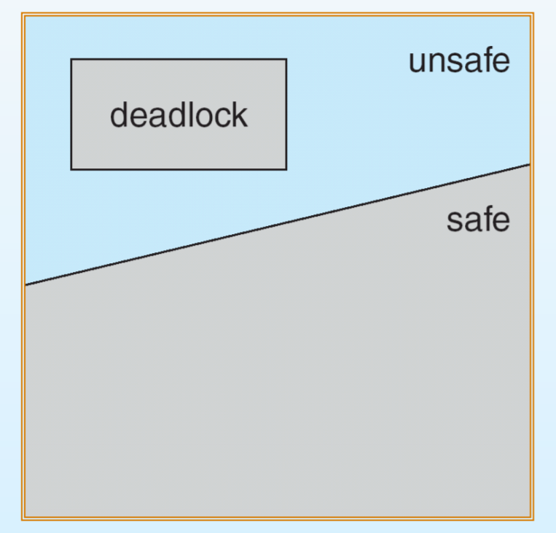
Safe, Unsafe , Deadlock State

Slide 30
RESOURCE-ALLOCATION GRAPH ALGORITHM
The resource allocation graph is the pictorial representation of the state of a system.
As its name suggests, the resource allocation graph is the complete information about all the processes which are holding some resources or waiting for some resources.
It also contains the information about all the instances of all the resources whether they are available or being used by the processes.
In Resource allocation graph, the process is represented by a Circle while the Resource is represented by a rectangle.
Let's see the types of vertices and edges in detail.

Slide 31
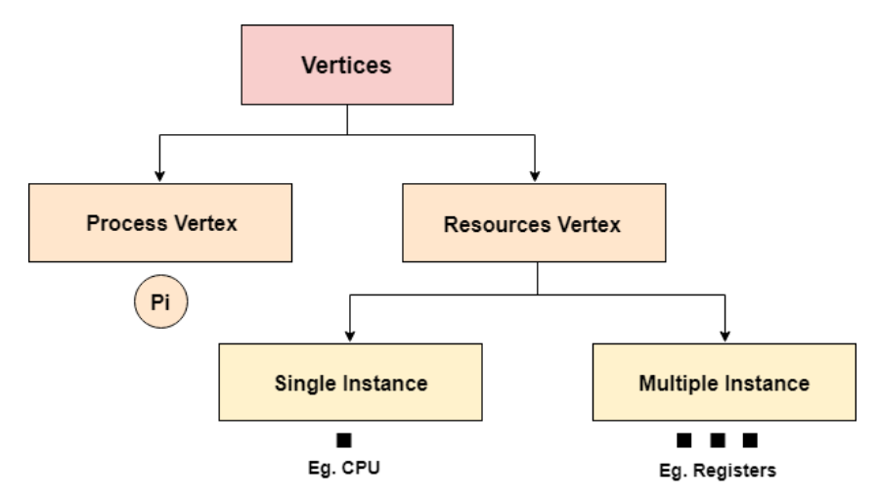
RESOURCE-ALLOCATION GRAPH ALGORITHM

Slide 32
RESOURCE-ALLOCATION GRAPH ALGORITHM
Vertices are mainly of two types, Resource and process.
Each of them will be represented by a different shape.
Circle represents process while rectangle represents resource.
A resource can have more than one instance. Each instance will be represented by a dot inside the rectangle.

Slide 33
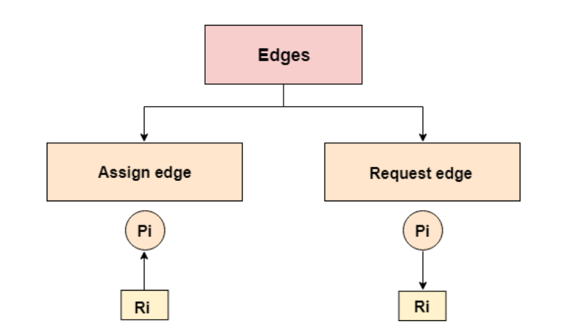
RESOURCE-ALLOCATION GRAPH ALGORITHM

Slide 34
RESOURCE-ALLOCATION GRAPH ALGORITHM
Edges in RAG are also of two types, one represents assignment and other represents the wait of a process for a resource. The above image shows each of them.
A resource is shown as assigned to a process if the tail of the arrow is attached to an instance to the resource and the head is attached to a process.
A process is shown as waiting for a resource if the tail of an arrow is attached to the process while the head is pointing towards the resource.

Slide 35
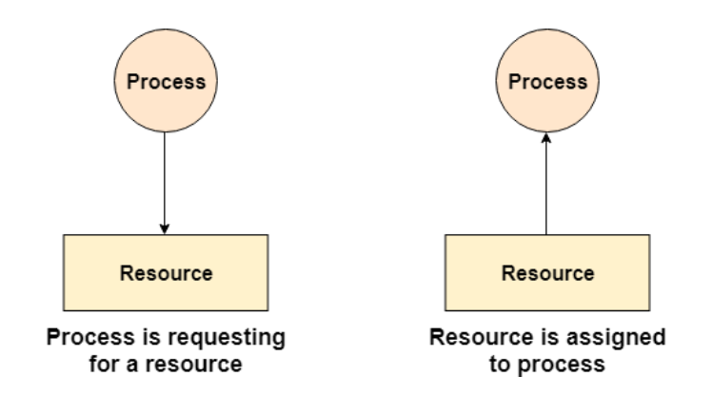

Slide 36
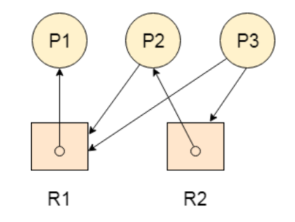
EXAMPLE
Let's consider 3 processes P1, P2 and P3, and two types of resources R1 and R2. The resources are having 1 instance each.
According to the graph, R1 is being used by P1, P2 is holding R2 and waiting for R1, P3 is waiting for R1 as well as R2.
The graph is deadlock free since no cycle is being formed in the graph.

Slide 37
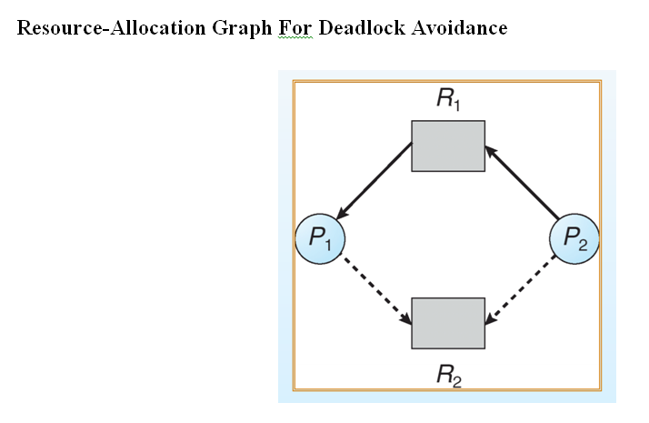

Slide 38
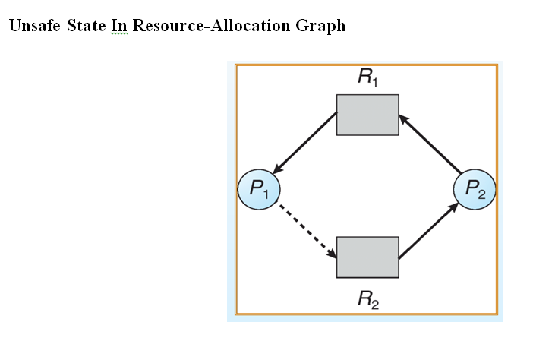

Slide 39
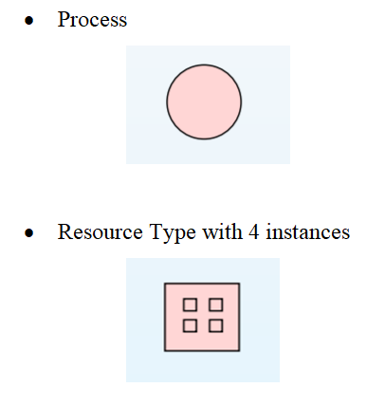
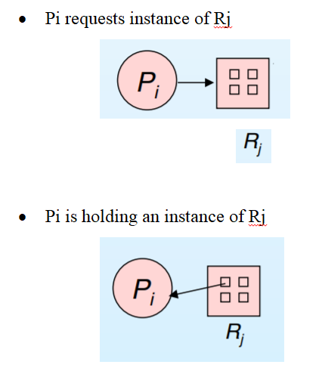
RAG ALGORITHM

Slide 40
DEADLOCK AVOIDANCE : BANKER’S ALGORITHM
Multiple instances.
Each process must a priori claim maximum use.
When a process requests a resource it may have to wait.
When a process gets all its resources it must return them in a finite amount of time.

Slide 41
BANKER’S ALGORITHM
Banker's algorithm is a deadlock avoidance algorithm.
It is named so because this algorithm is used in banking systems to determine whether a loan can be granted or not.
Example as follows……………

Slide 42
BANKER’S ALGORITHM
Consider there are n account holders in a bank and the sum of the money in all of their accounts is S.
Everytime a loan has to be granted by the bank, it subtracts the loan amount from the total money the bank has.
Then it checks if that difference is greater than S.
It is done because, only then, the bank would have enough money even if all the n account holders draw all their money at once.

Slide 43
BANKER’S ALGORITHM
Banker's algorithm works in a similar way in computers.
Whenever a new process is created, it must specify the maximum instances of each resource type that it needs, exactly.
Let us assume that there are n processes and m resource types. Some data structures that are used to implement the banker's algorithm are:
AVAILABLE
MAX
ALLOCATION
NEED

Slide 44
BANKER’S ALGORITHM
Available
It is an array of length m. It represents the number of available resources of each type.
If Available[j] = k, then there are k instances available, of resource type R(j).
Max
It is an n x m matrix which represents the maximum number of instances of each resource that a process can request.
If Max[i][j] = k, then the process P(i) can request atmost k instances of resource type R(j).

Slide 45
BANKER’S ALGORITHM
Allocation
It is an n x m matrix which represents the number of resources of each type currently allocated to each process.
If Allocation[i][j] = k, then process P(i) is currently allocated k instances of resource type R(j).
Need
It is an n x m matrix which indicates the remaining resource needs of each process.
If Need[i][j] = k, then process P(i) may need k more instances of resource type R(j) to complete its task.

Slide 46
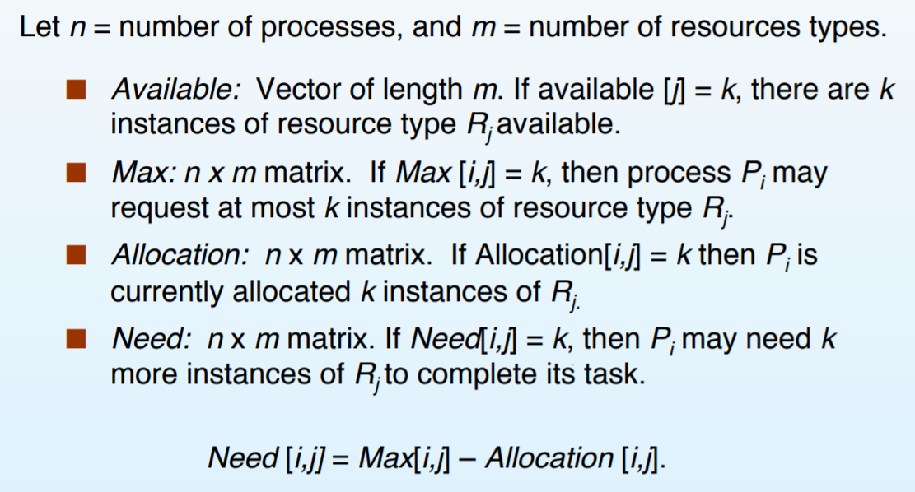
DATA STRUCTURES FOR BANKER’S ALGORITHM

Slide 47
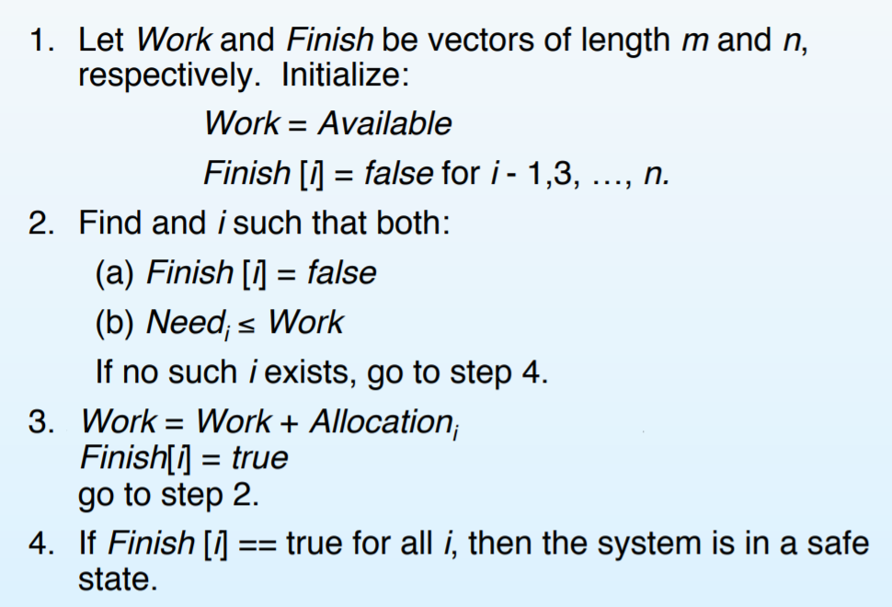
SAFETY ALGORITHM

Slide 48
RESOURCE-REQUEST ALGORITHM FOR PROCESS P_{i}
Request = request vector for process P_{i}
If Request_{i} [j] = k then process P_{i} wants k instances of resource type R_{j}.
If Request_{i} ≤ Need_{i} go to step 2. Otherwise, raise error condition, since process has exceeded its maximum claim.
If Request_{i} ≤ Available, go to step 3. Otherwise P_{i} must wait, since resources are not available.

Slide 49
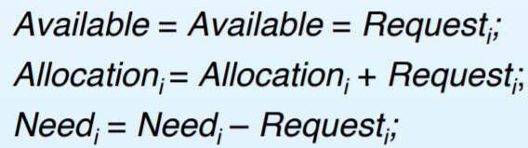
RESOURCE-REQUEST ALGORITHM FOR PROCESS P_{i}
If safe ⇒ the resources are allocated to Pi.
If unsafe ⇒ Pi must wait, and the old resource-allocation state is restored

Slide 50
Resource Request Algorithm
This describes the behaviour of the system when a process makes a resource request in the form of a request matrix. The steps are:
If number of requested instances of each resource is less than the need (which was declared previously by the process), go to step 2.
If number of requested instances of each resource type is less than the available resources of each type, go to step 3. If not, the process has to wait because sufficient resources are not available yet.

Slide 51
Resource Request Algorithm
This step is done because the system needs to assume that resources have been allocated.
So there will be less resources available after allocation.
The number of allocated instances will increase.
The need of the resources by the process will reduce.
That's what is represented by the above three operations.

